Slide 1
SOUTH END COMMUNITY DAY CARE
Aleysha Mullen
Angela Dini
Azeem Ali
Negin Sauermann
Rami Khashmelmous

Slide 2
PRESENTATION OVERVIEW
Project Overview
Scope
Progress
Obstacles
Demo

Slide 3

PROJECT OVERVIEW
Notes:
Project Overview
The South End Community Day Care and the parents of its students need an updated website providing detailed information about the facility. The daycare staff would also like to facilitate some of their administrative efforts by moving the daycare waitlist online, as well as the storage and management of medical records.
The South End Day Care Community Outreach team will provide the daycare with an updated website that, unlike the current site, provides the ability to add video content, update the daycare status, and manage the waitlist. The team will provide training on how to use the new features. The team will also research the online management of medical records and provide their findings, and recommendations to the client.

Slide 4

SCOPE
Notes:
In Scope:
New design/layout for the website
The ability to add video content
An open/closed status feature
A waiting list feature
A detailed instruction manual for administrating the website
Training sessions for the website administrator
Research and recommendations for online file storage and online medical record management
Deployment of new website to client server**
Out of Scope:
Guaranteed support for multiple device screen sizes/resolution
Ongoing maintenance of client website
Implementation of online file storage and sharing
Implementation of online medical record management

Slide 5
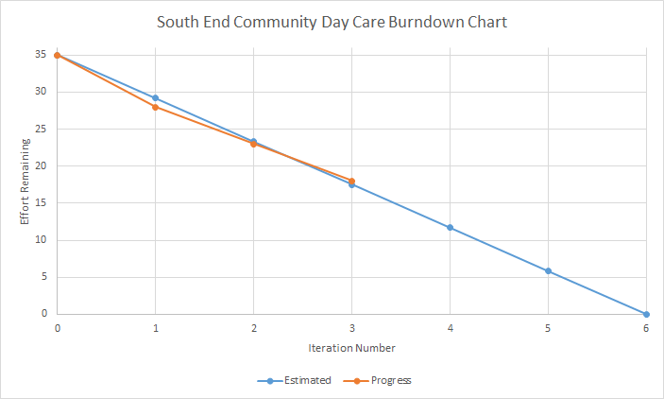
PROGRESS: What have we done?
Notes:
What have we done?
Implemented a daycare status feature
Implemented an event calendar feature
Begun development of the waiting list feature
Developed two new layouts for client feedback

Slide 6

PROGRESS: What is left to do?
Notes:
What is left to do?
Implement design selected by clients
Complete implementation of waiting list feature
Complete documentation and instructions
Create a report outlining research and recommendations
Deploy website to client server**
Complete training sessions

Slide 7

OBSTACLES
Notes:
Obstacles:
WordPress learning curve
Finding free plugins, or full versions of plugins
Finding plugins that meet the requirements of the feature being implemented

Slide 8

DEMO
Notes:
Rami’s Traditional Layout (Demo 1)
Pros:
Intuitive navigation
Easy to maintain
Scalable
Cons:
Too many pages may make navigation confusing
Negin’s Parallax Layout (Demo 2)
Pros:
Designed for mobile devices
Modern and trending layout
Linear flow of information
Cons:
Navigation may not be intuitive
May be more difficult to maintain
Adding many features may clutter and slow the website

Slide 9
QUESTIONS?

Slide 10
IMAGE REFERENCES
Demo Related Keywords & Suggestions - Demo Long Tail Keywords. (2016). Keyword-suggestions.com. Retrieved from http://www.keyword-suggestions.com/ZGVtbw/
'Healthcare & Medicine' by Laura Reen. (2016). Iconfinder. Retrieved from https://www.iconfinder.com/icons/311913/clock_schedule_time_management_timetable_icon
Scope Clip Art | Clipart Panda - Free Clipart Images. (2016). Clipartpanda.com. Retrieved from http://www.clipartpanda.com/categories/scope-clip-art
South End Community Day Care | Non-profit community day care in Halifax, Nova Scotia, Canada. (2016). Secdc.ca. Retrieved from http://secdc.ca/
Synopses of Numbers 12 - 22 of 66 Obstacles to a Successful Business Sale | How to Sell a Business Newsletter | Issue #25. (2016). Howtoplanandsellabusiness.com. Retrieved from http://howtoplanandsellabusiness.com/how-to-sell-a-business-newsletters/synopses-of-numbers-12-22-of-66-obstacles-to-a-successful-business-sale/

